Slide 1
Proposal for Oak Framed Gazebo
For Sample Client
28 January
Quotation Reference:

Slide 2
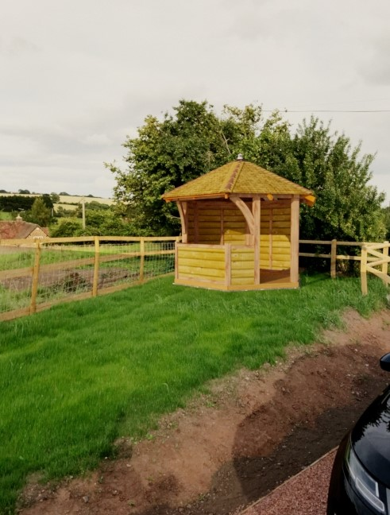
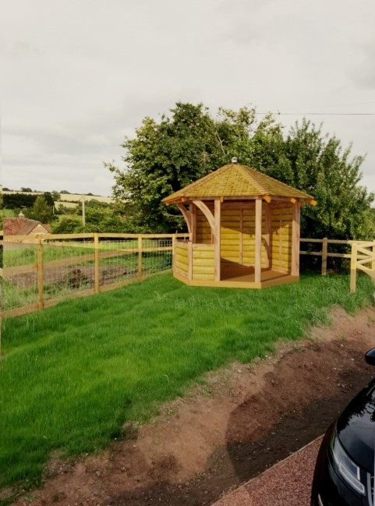
Oak Framed Gazebo - Images
Gazebo rotated by 30 degrees

Slide 3
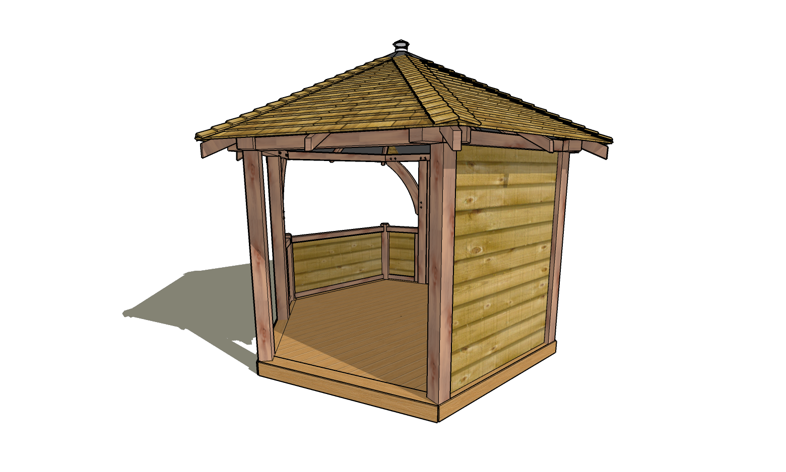
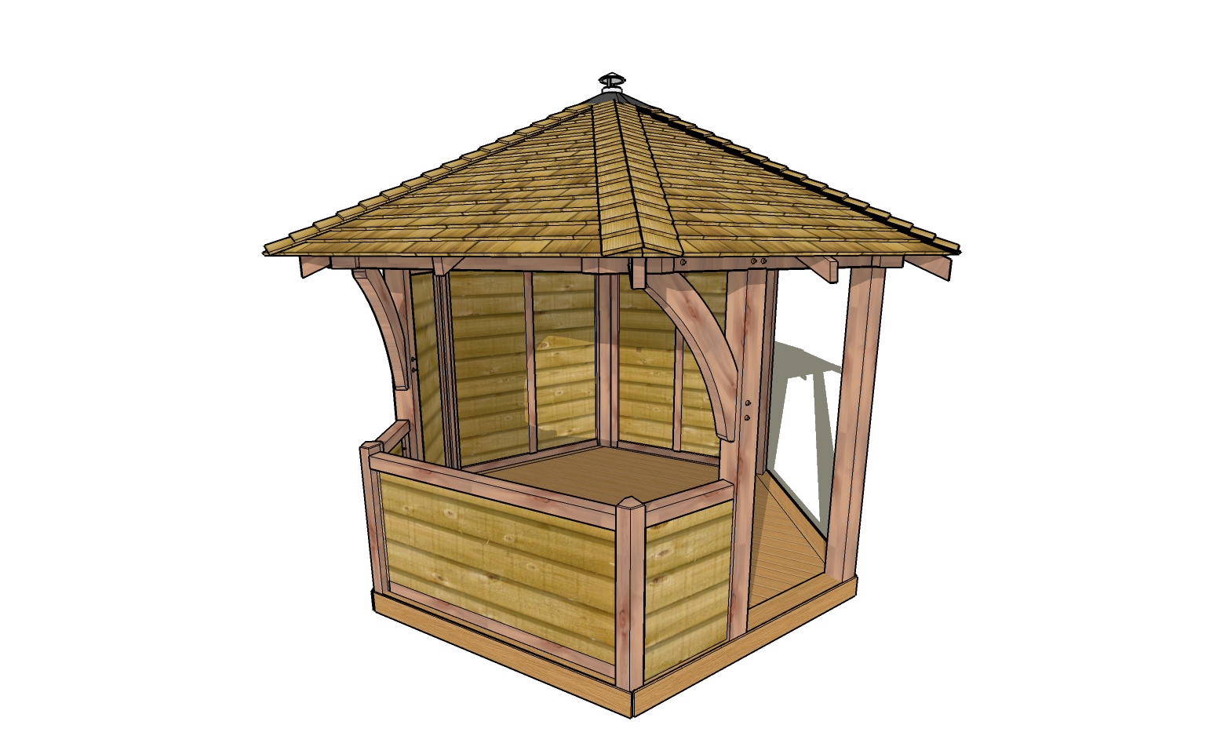
Views

Slide 4
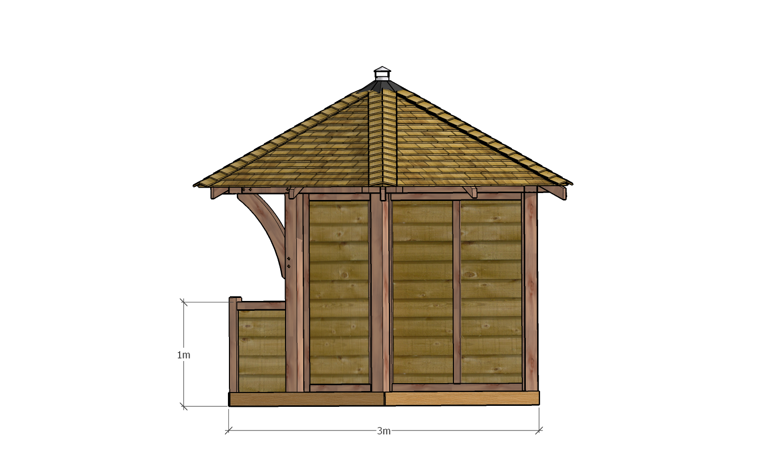
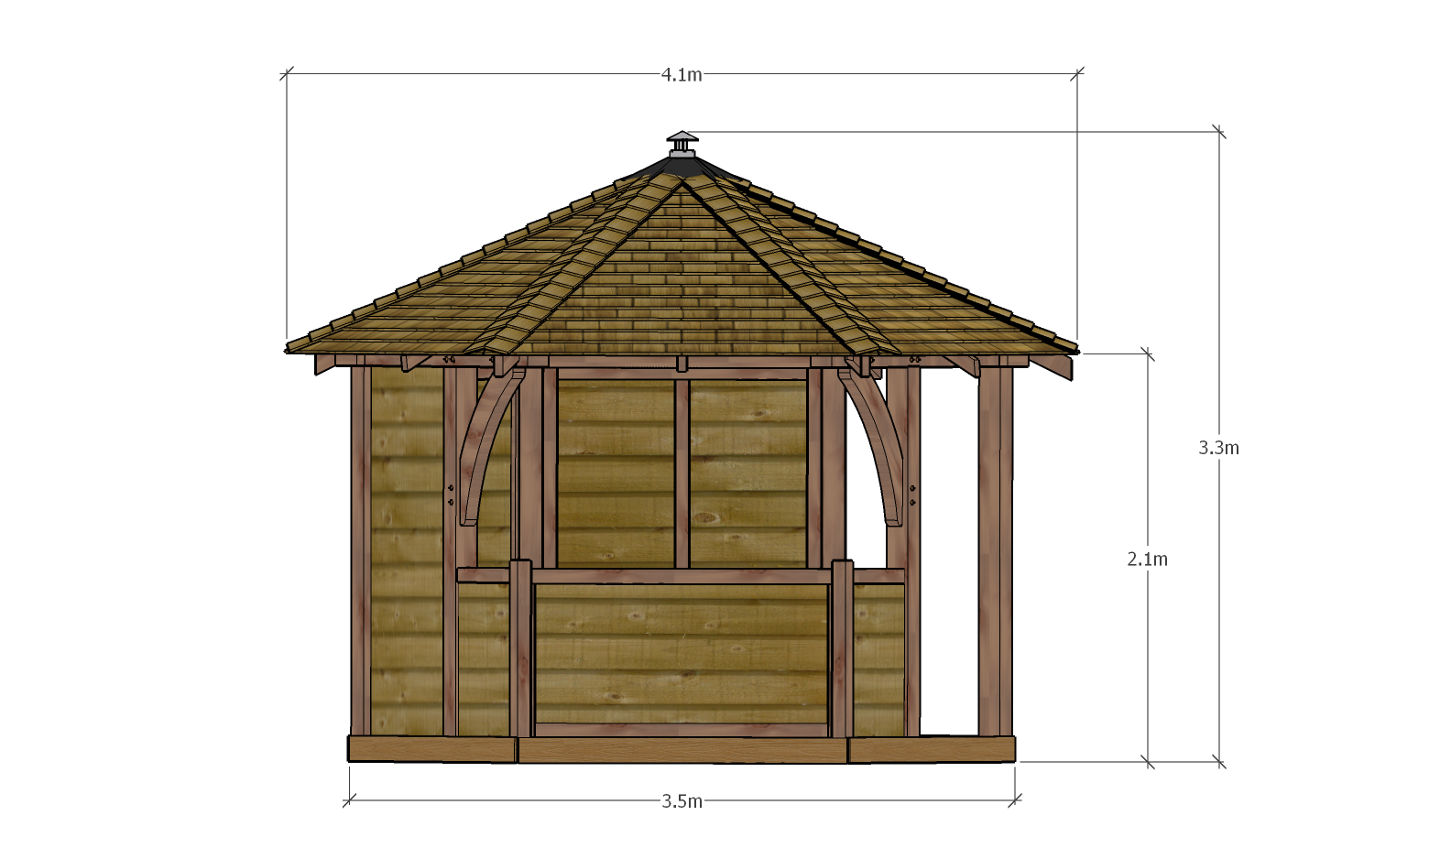
Overall Sizes
SIDE ELEVATION (through opening)
FRONT ELEVATION

Slide 5
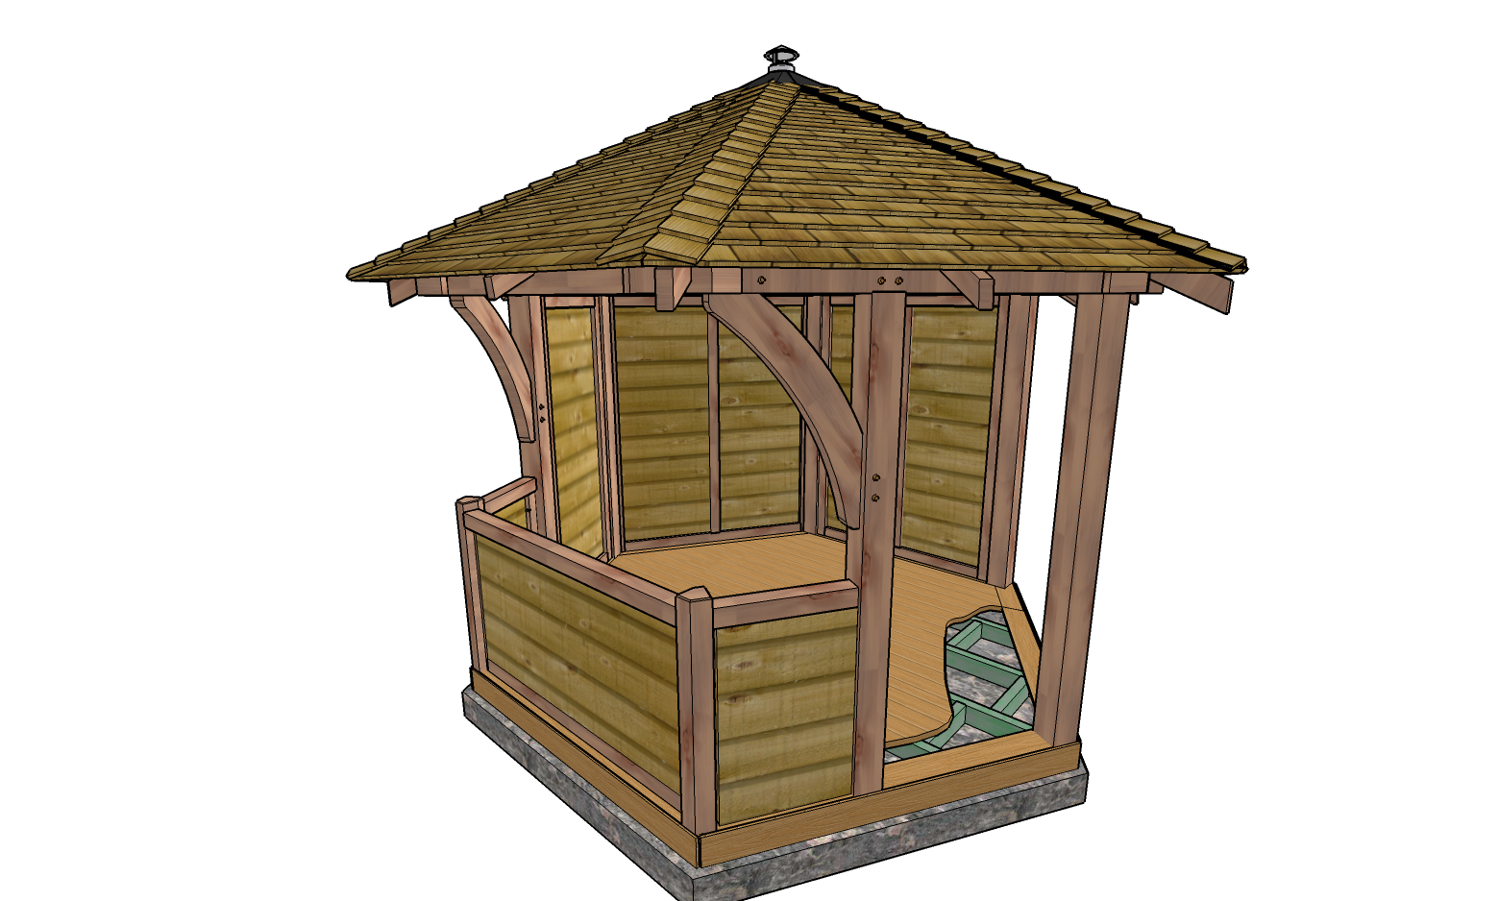
Features
Chimney cowl vent
Larch shingles
Green Oak Frame
“Swans neck” braces
125 x 125 Oak Posts
Oak hand rail
Composite Decking
150 or 200mm wide Larch cladding
Treated “4 x 2 in” deck base
Composite edging
to match decking

Slide 6
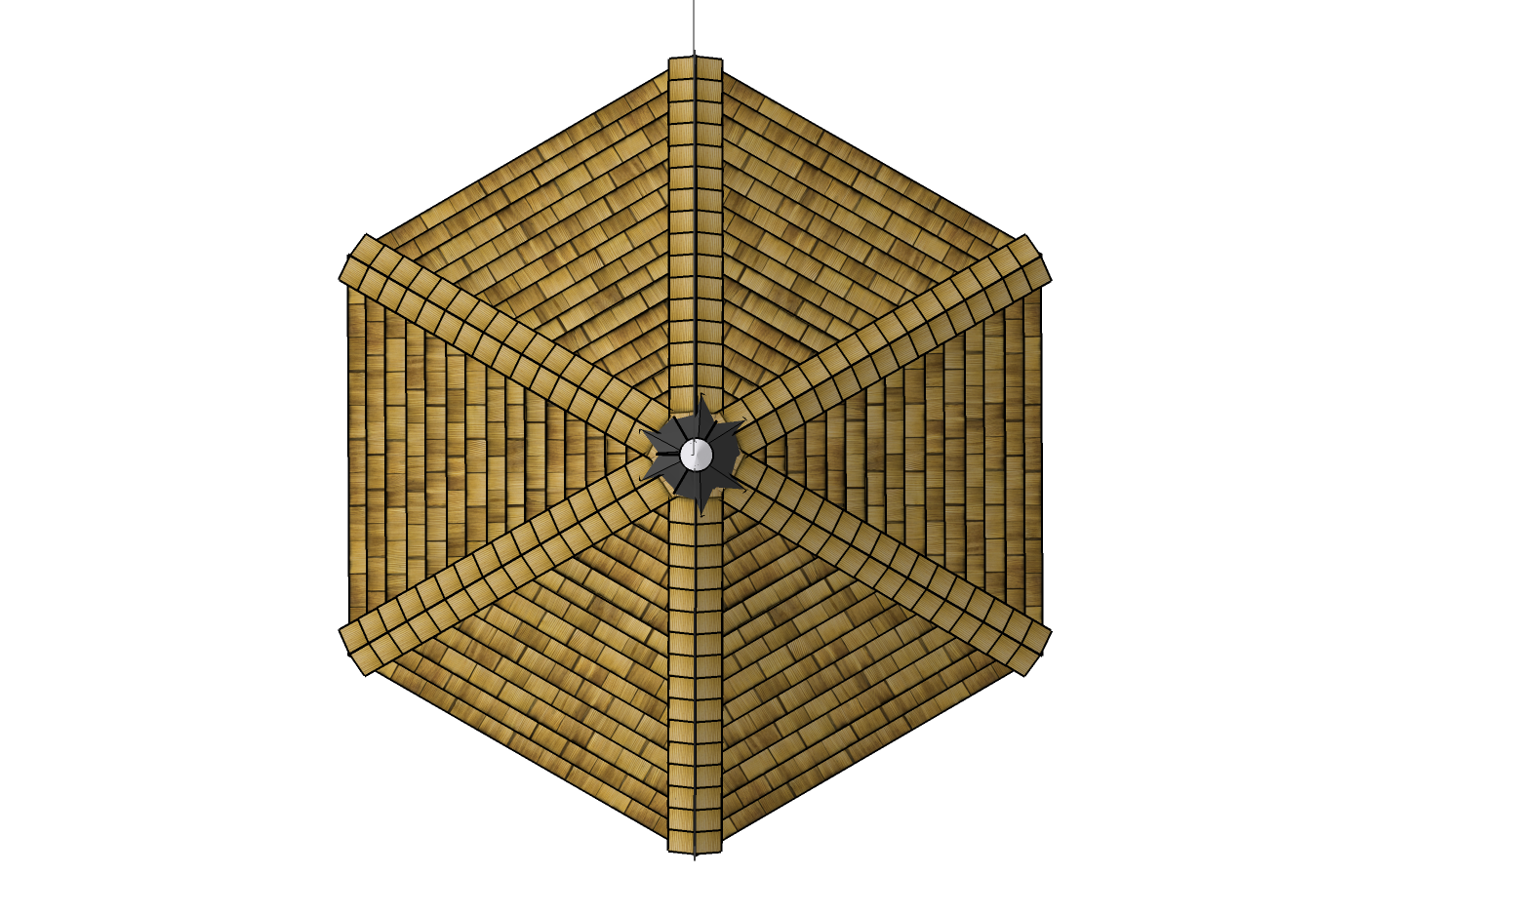
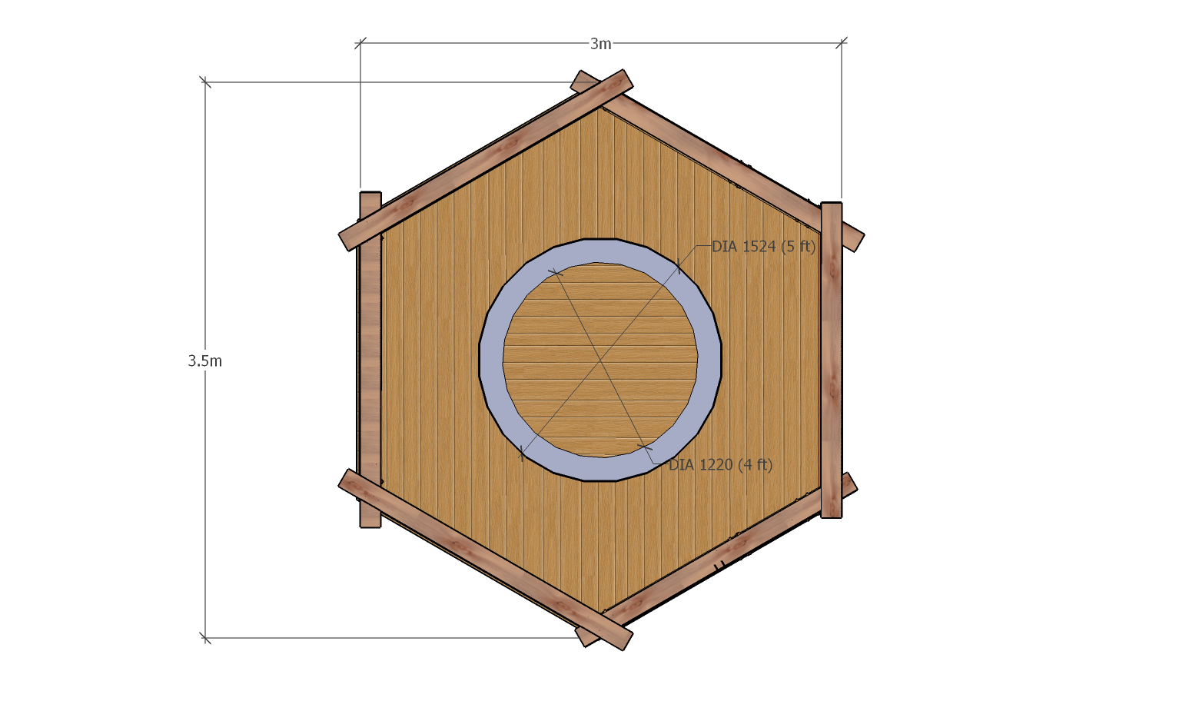
Plan views
PLAN VIEW WITH ROOF REMOVED
SHOWING POTENTIAL TABLE SIZES

Slide 7
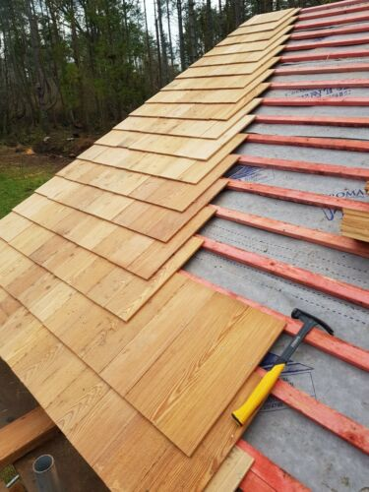
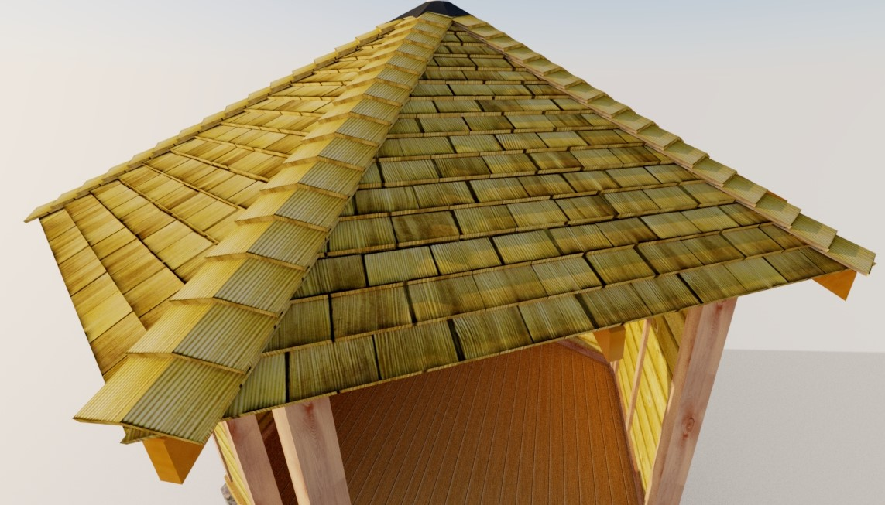
Roof Shingles
Larch 10mm Thick Roof Shingles

Slide 8
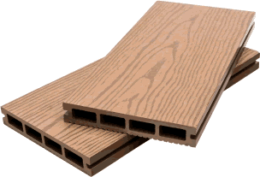
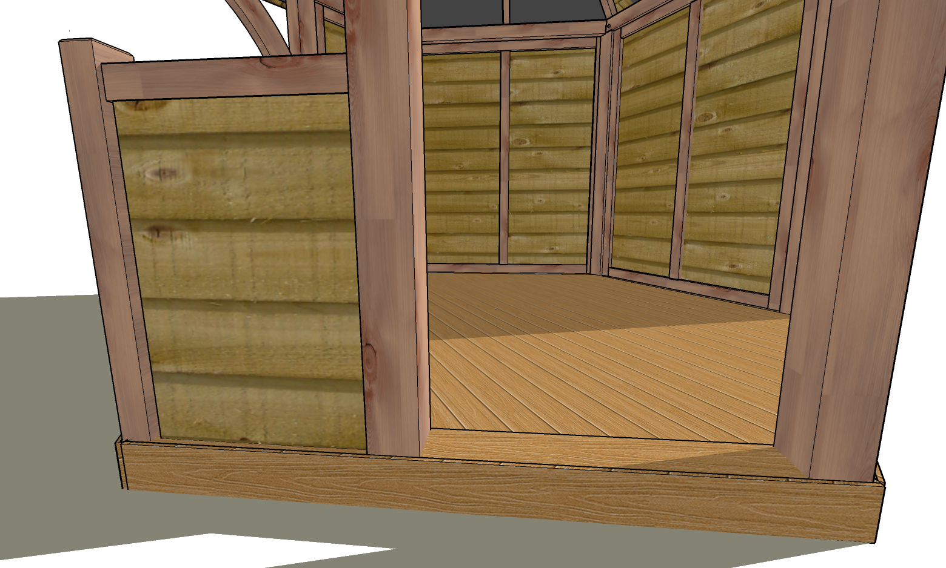
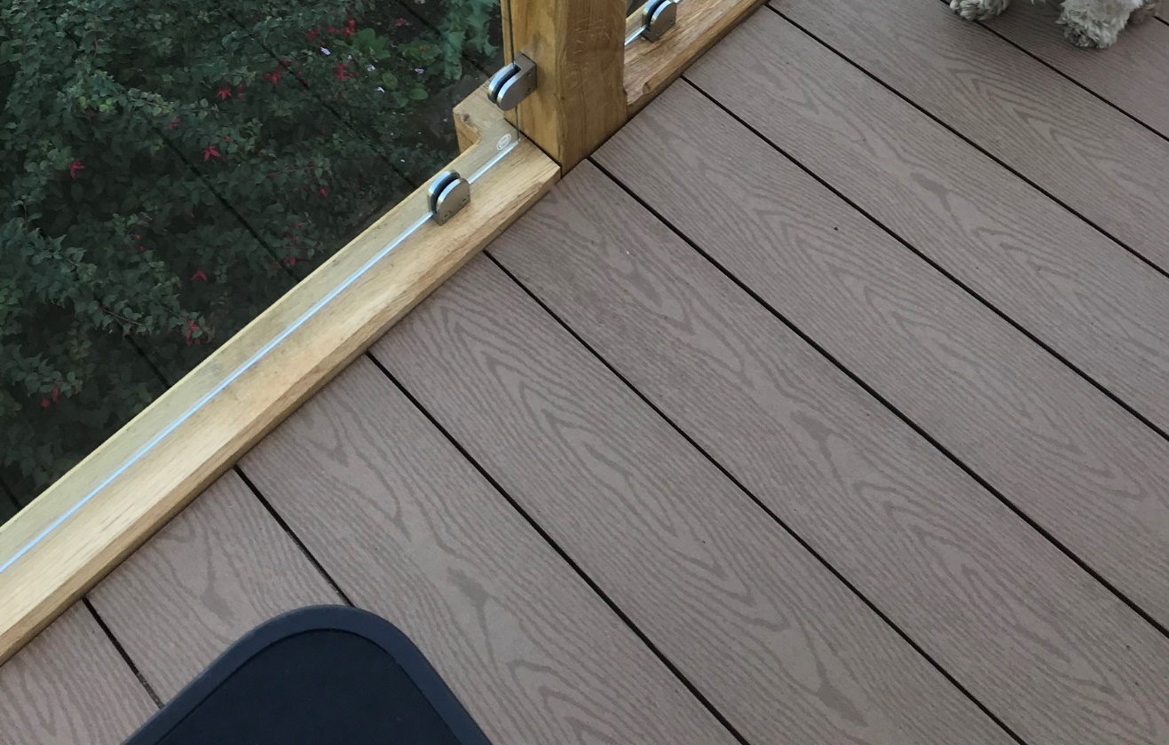
Decking
Proposed Decking
Composite 150 mm wide
Choice of colours
Client: Sample Client
Date: 28 January

Slide 9
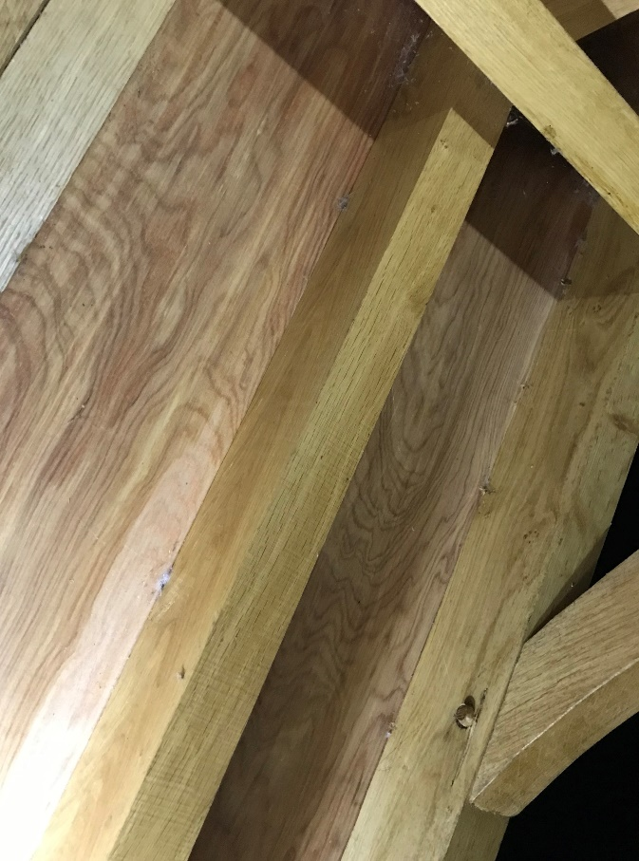
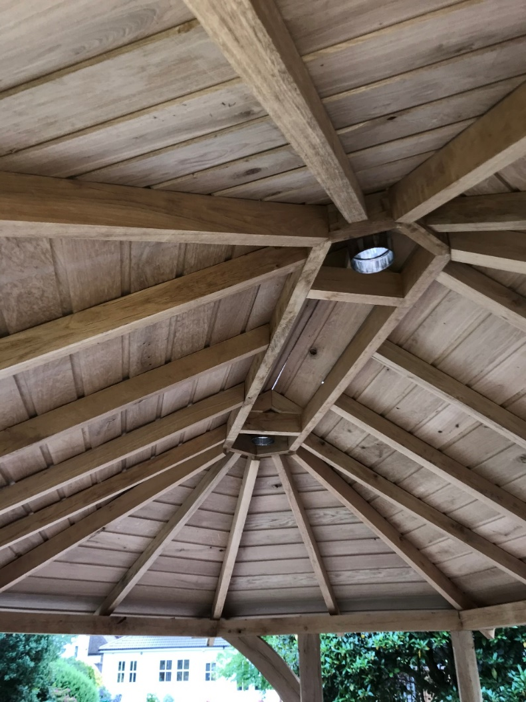
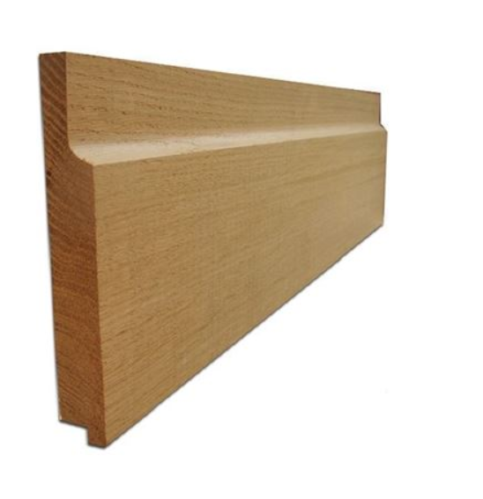
Alternative Roofing Options
Exterior Grade Plywood *
150mm wide kiln dried shiplap oak *
* Additional cost options

Slide 10
Oak Framed Gazebo Quotation
Gazebo quotation includes:
Frame
All posts and main structural members are 125mm square. Head beams are 125 x 100mm.
All Oak roof members.
2 “swans neck” knee braces.
Deck
150mm wide composite decking as shown with choice of colours.
Treated deck frame.
Composite edge & frame around the deck boards.
Roof
Vented Roof
Larch roof shingles
Optional Oak Shiplap Cladding or external hardwood plywood. (extra cost).
Base
Footings will be required prior to installation. It is recommended that a full concrete base is install that is 50-100mm larger in size than the gazebo. (Not included in quotation).
Quotation includes:
Detailed design changes to clients agreed specification, based on outline design in images.
The gazebo is hand manufactured in green oak & larch as shown.
Oak frame, all decking – which is composite, decking frame & fixings, roof timbers, shingles, battens & roof cowl.
Delivery & installation.
Pre- installation site assessment.
Fixings
Oak dowels for all dowelled joints are provided.
Stainless steel screws for all screwed fixings.
Finish
The gazebo is pre-assembled to ensure trouble free on-site installation.
All oak is finish planed & sanded.
The recommended treatment is two coats of Osmo UV protection oil.
Total Cost:
£ XXXX.XX – 3m Hexagonal Gazebo
Terms: 60% deposit to be paid on placement of order with the balance to be paid on delivery.
Delivery is 6-7 weeks from placement of order.

